Slide 1
Recent developed algorithms for control / system engineering regarding to Windfarm
Unscented Kalman Filter
+ fault detection for a wind turbine
2. Quasilinear control
+ the output power of a windfarm by the quasilinear windfarm controller
3.Global Sensitivity Analysis
+ investigate the effect of the wake due to upstream wind turbine
+ wake control
4. Miscellaneous
- the prediction of the output power of the wind farm
- AAU “Master Thesis”

Slide 2
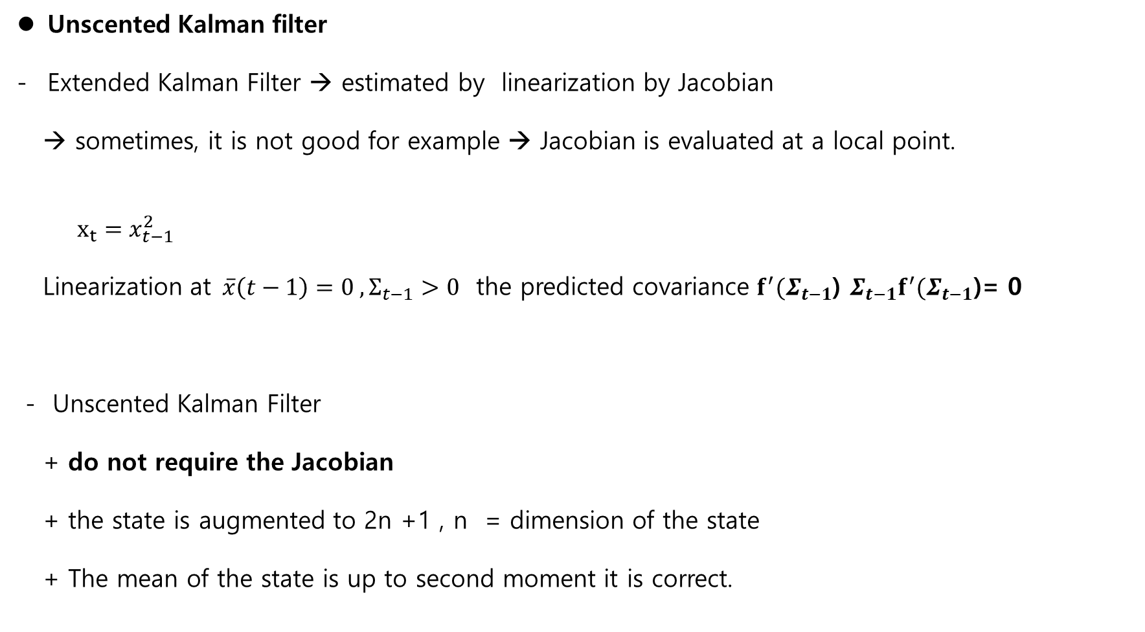
UKF
Unscented Kalman filter
Extended Kalman Filter → estimated by linearization by Jacobian
→ sometimes, it is not good for example → Jacobian is evaluated at a local point.
$x_{t}=x_{t−1}^{2}$
Linearization at$\overline{x}\left(t−1\right)=0 ,Σ_{t−1}>0$ the predicted covariance $f^{′}(Σ_{t−1}$) $Σ_{t−1}f^{′}(Σ_{t−1}\text{)}$= 0
- Unscented Kalman Filter
+ do not require the Jacobian
+ the state is augmented to 2n +1 , n = dimension of the state
+ The mean of the state is up to second moment it is correct.

Slide 3
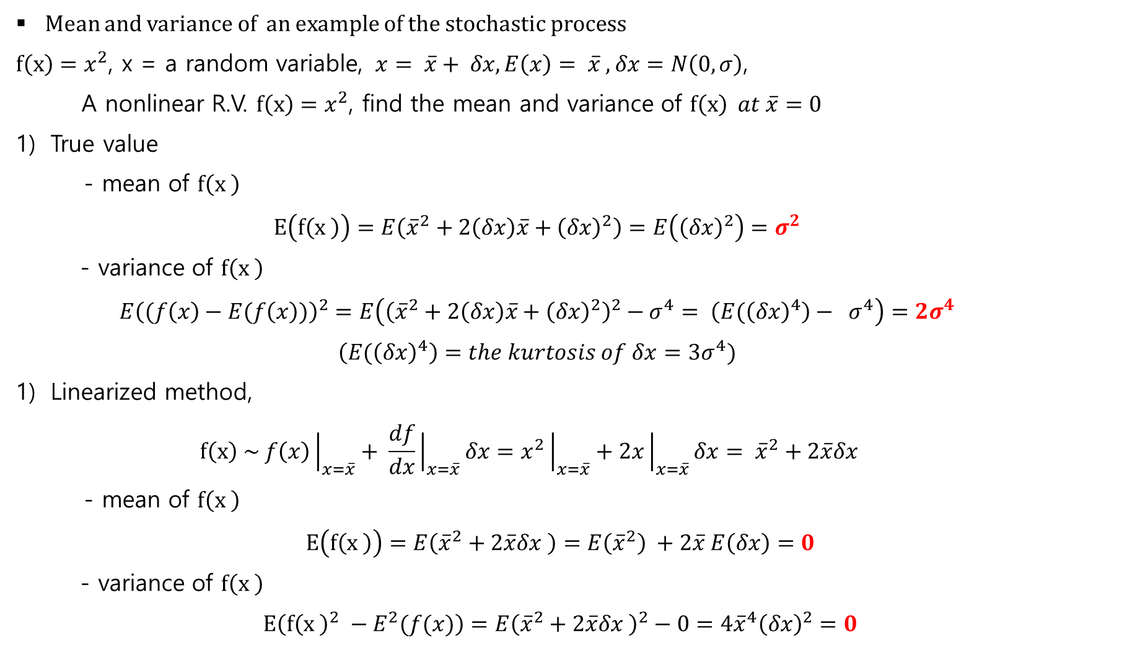
UKF
Mean and variance of an example of the stochastic process
$f\left(x\right)=x^{2}$, x = a random variable, $x= \overline{x}+ δx, E\left(x\right)= \overline{x} ,δx=N\left(0, σ\right)$,
A nonlinear R.V. $f\left(x\right)=x^{2}$, find the mean and variance of $f\left(x\right) at \overline{x}=0$
True value
- mean of $f\left(x \right)$
$$E\left(f\left(x \right)\right)=E\left({\overline{x}}^{2}+2\left(δx\right)\overline{x}+{\left(δx\right)}^{2}\right)=E\left({\left(δx\right)}^{2}\right)=σ^{2}$$
- variance of $f\left(x \right)$
$$E{\left((f\left(x\right)−E(f\left(x\right))\right)}^{2}=E\left({\left({\overline{x}}^{2}+2\left(δx\right)\overline{x}+{\left(δx\right)}^{2}\right)}^{2}−σ^{4}= \left(E{(\left(δx\right)}^{4}\right)− σ^{4}\right)=2σ^{4}$$
$$\left(E{(\left(δx\right)}^{4}\right)=the kurtosis of δx=3σ^{4})$$
Linearized method,
$$f\left(x\right) \sim f\left(x\right){\left.​\right|}_{x=\overline{x}}+ \frac{df}{dx}{\left.​\right|}_{x=\overline{x}}δx=x^{2}{\left.​\right|}_{x=\overline{x}}+2x{\left.​\right|}_{x=\overline{x}}δx= {\overline{x}}^{2}+2\overline{x}δx$$
- mean of $f\left(x \right)$
$$E\left(f\left(x \right)\right)=E\left({\overline{x}}^{2}+2\overline{x}δx \right)=E\left({\overline{x}}^{2}\right) +2\overline{x} E\left(δx\right)=0$$
- variance of $f\left(x \right)$
$$E\left(f{\left(x \right)}^{2} −E^{2}(f(x)\right)=E{\left({\overline{x}}^{2}+2\overline{x}δx \right)}^{2}−0=4{\overline{x}}^{4}{\left(δx\right)}^{2}=0$$

Slide 4
UKF
3) Kalman filter algorithm – necessities
- state modeling of the dynamic system
- mean of the states
- covariance of the states
EKF : need Jacobian of the system dynamics for covariance
Unscented Kalman filter :
- no need Jacobian
- need (2n+1) sigma points of the states(n-dimension)
- provide the mean of states as precise as the second moments
(the previous example, the mean by the unscented Kalman is the true mean)
- numerical complexity

Slide 5
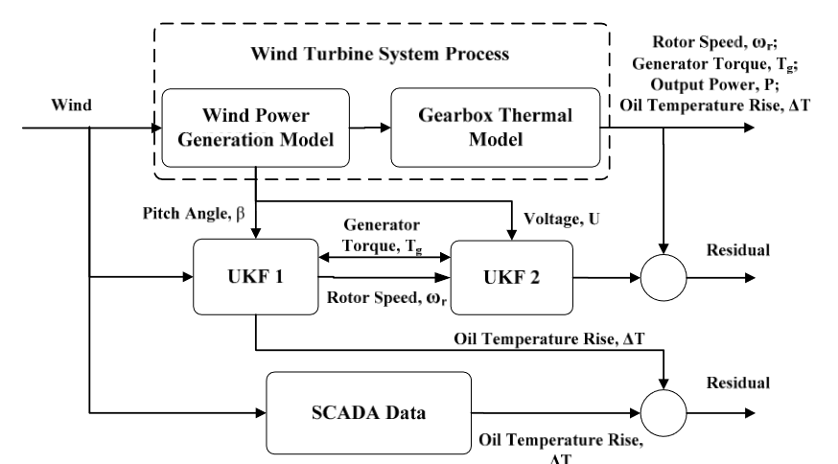
UKF
4) “Study of Wind Turbine Fault Diagnosis Based on Unscented Kalman Filter and SCADA Data”, 2016
Fault 1: wearing of gear box
Fault 2: Lubricating oil leakage
Fault 3: Pitch system failure
Procedure
- validation UKF with the simulation model
- comparison UKF with SCADA data
+ with real fault (2007 WT gearbox was replaced ) UKF is verified.

Slide 6
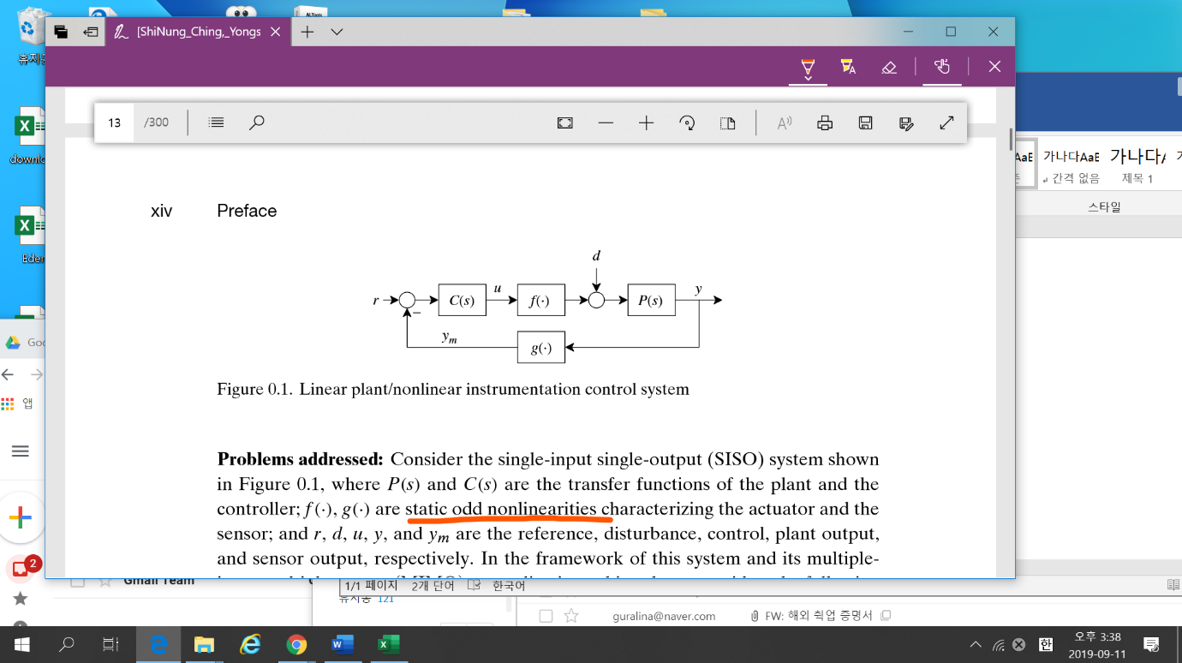
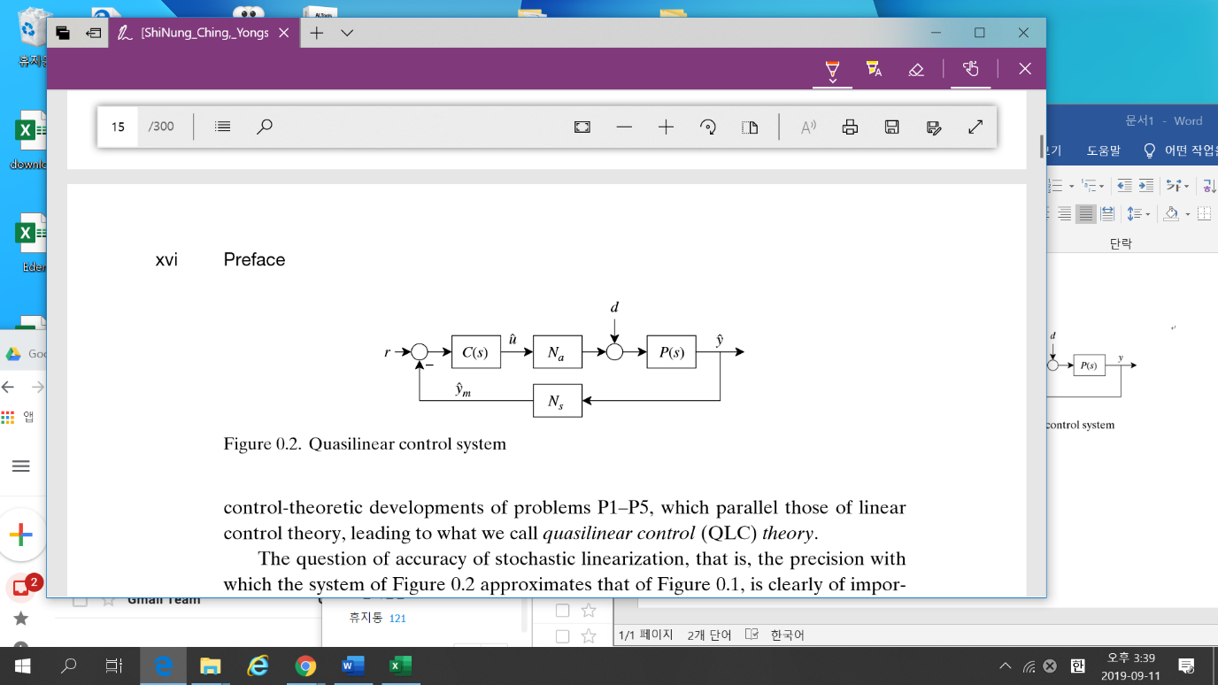
Quasilinear Control – stochastic linearization
Quasilinear
If $f\left(∙\right), g\left(∙\right)$ are static odd function nonlinearities, then if $P(s)$ is low-pass filtering,

Slide 7
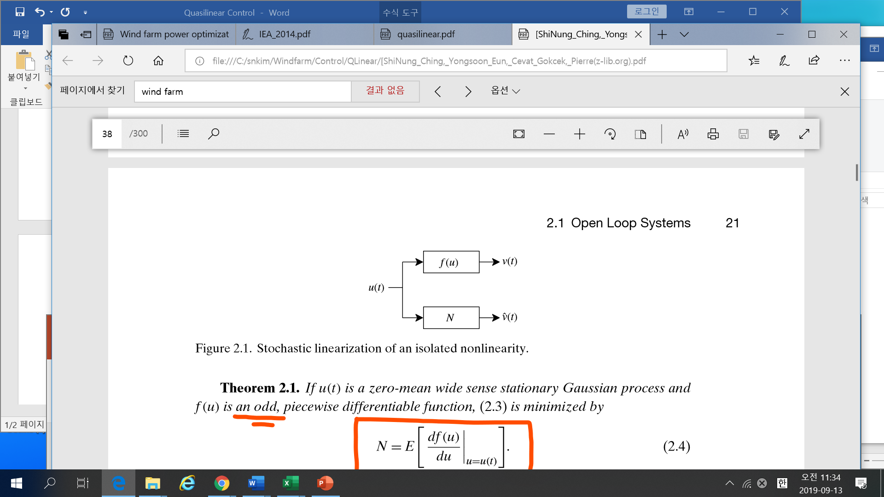
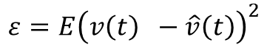
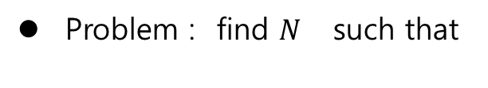
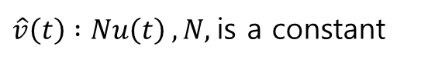
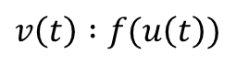
Quasilinear
1) f(u) is an odd piecewise differentiable function, u(t) is a zero-mean wide sense stationary (wss)
Gaussian process,
$u\left(t\right):$ a zero mean wide sense stationary Gaussian process(wss)
$f\left(u\right)$ : an odd piecewise differentiable function
$v\left(t\right) :f(u\left(t\right))$
$\hat{v}\left(t\right) :Nu\left(t\right) , N,$is a constant
Problem : find $N$ such that
$$ε=E{\left(v\left(t\right) −\hat{v}\left(t\right)\right)}^{2}$$

Slide 8
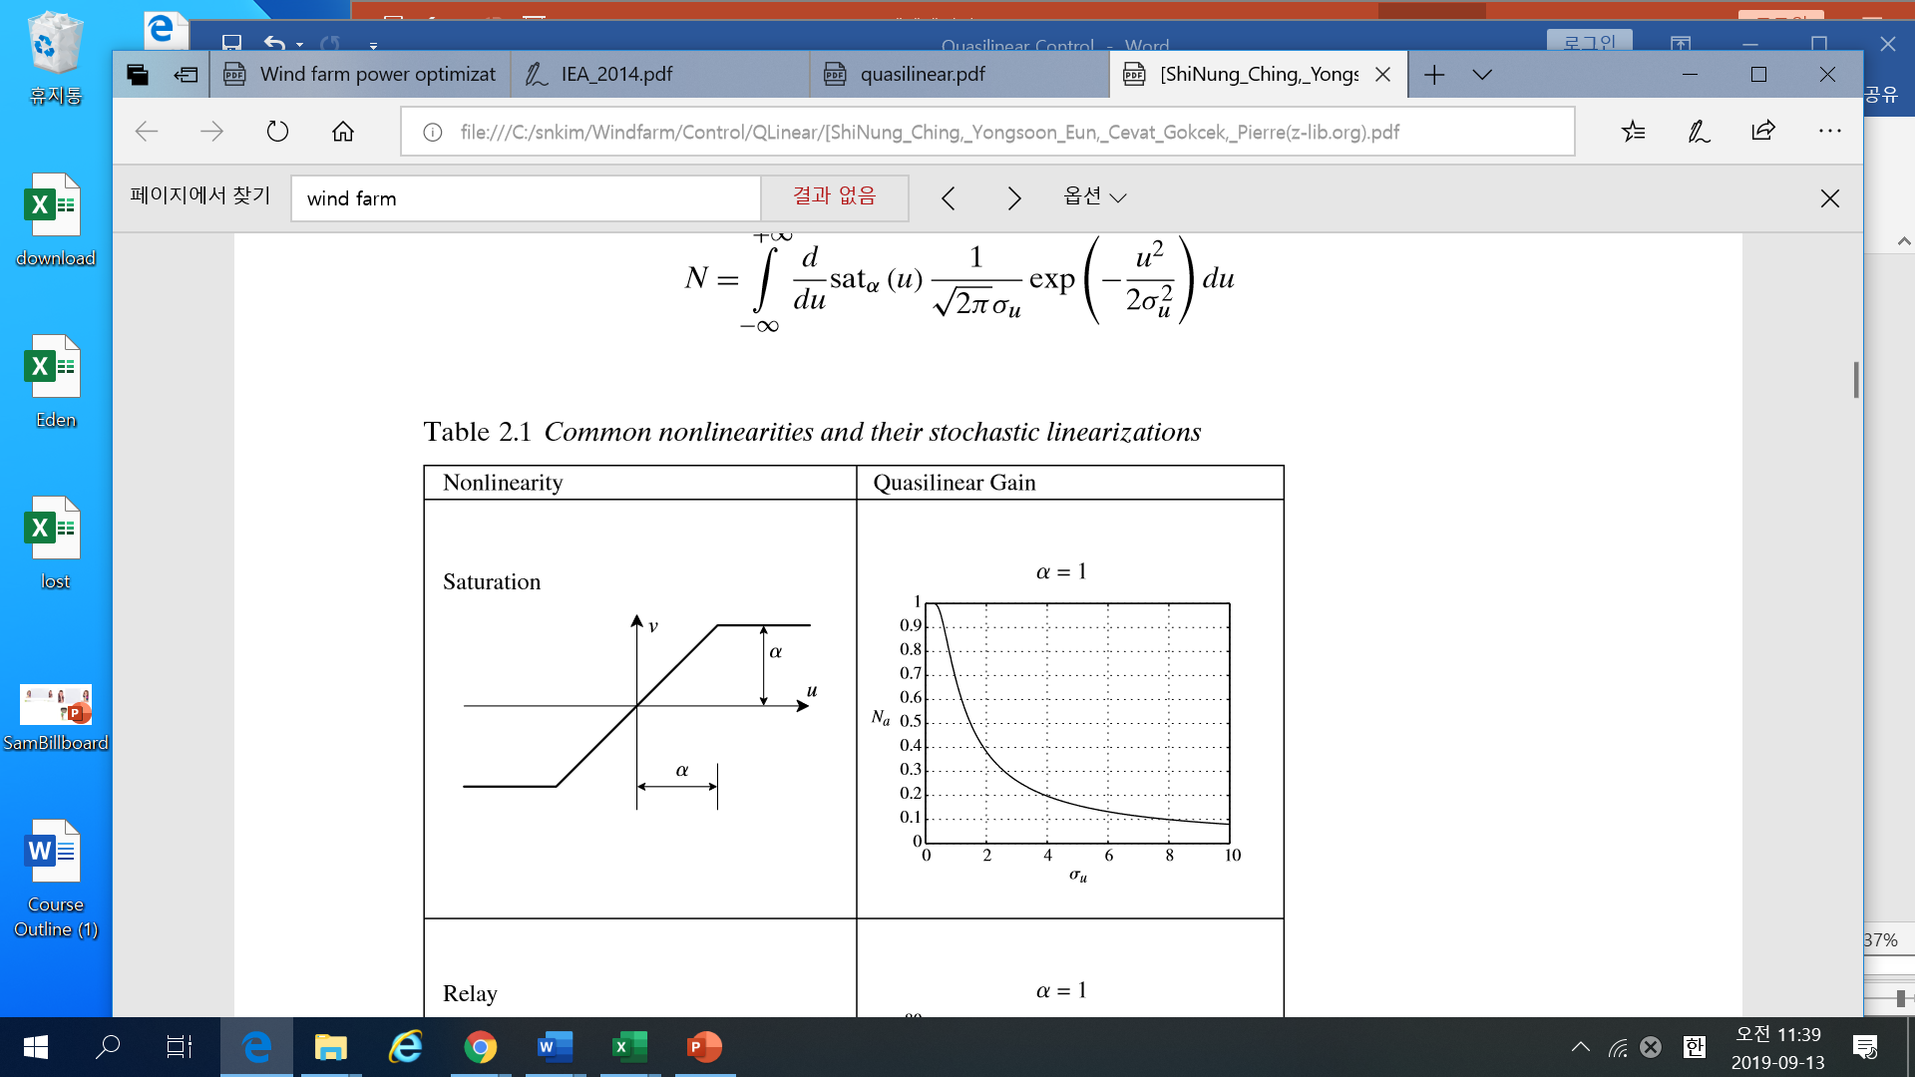
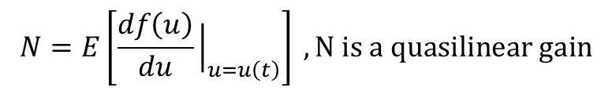
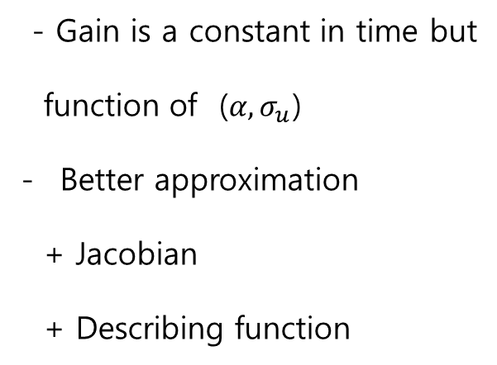
Theorem 2.1
Quasilinear
$$N=E\left[\frac{df\left(u\right)}{du}{\left.​\right|}_{u=u\left(t\right)}\right] , N is a quasilinear gain$$
Example : $u\left(t\right)$is a zero mean and std $σ_{u}$ gaussian. The piece wise function is a saturated function.
$N=E\left[\frac{df\left(u\right)}{du}{\left.​\right|}_{u=u\left(t\right)}\right]$ = $\int_{−∞}^{∞}{\frac{d}{du}sat_{α}\left(u\right)\frac{1}{\sqrt{2π}σ_{u} }\exp\left(−\frac{u^{2}}{2σ_{u}^{2}}\right)du}$
- Gain is a constant in time but
function of ($α,σ_{u}$)
Better approximation
+ Jacobian
+ Describing function

Slide 9
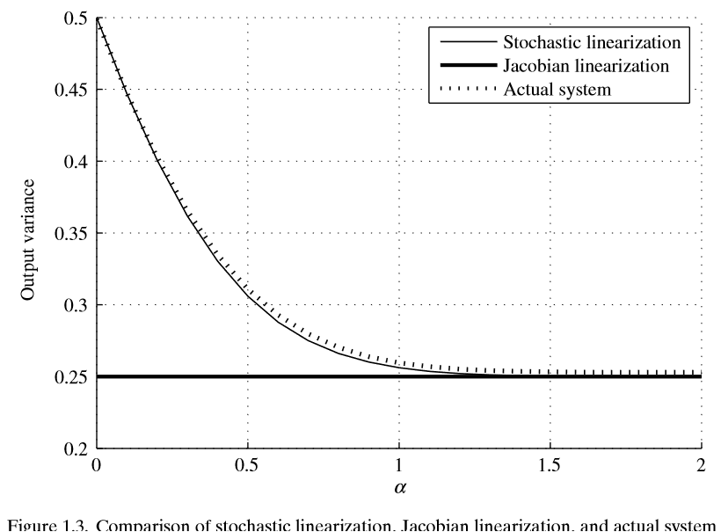
Quasilinear
Example :

Slide 10
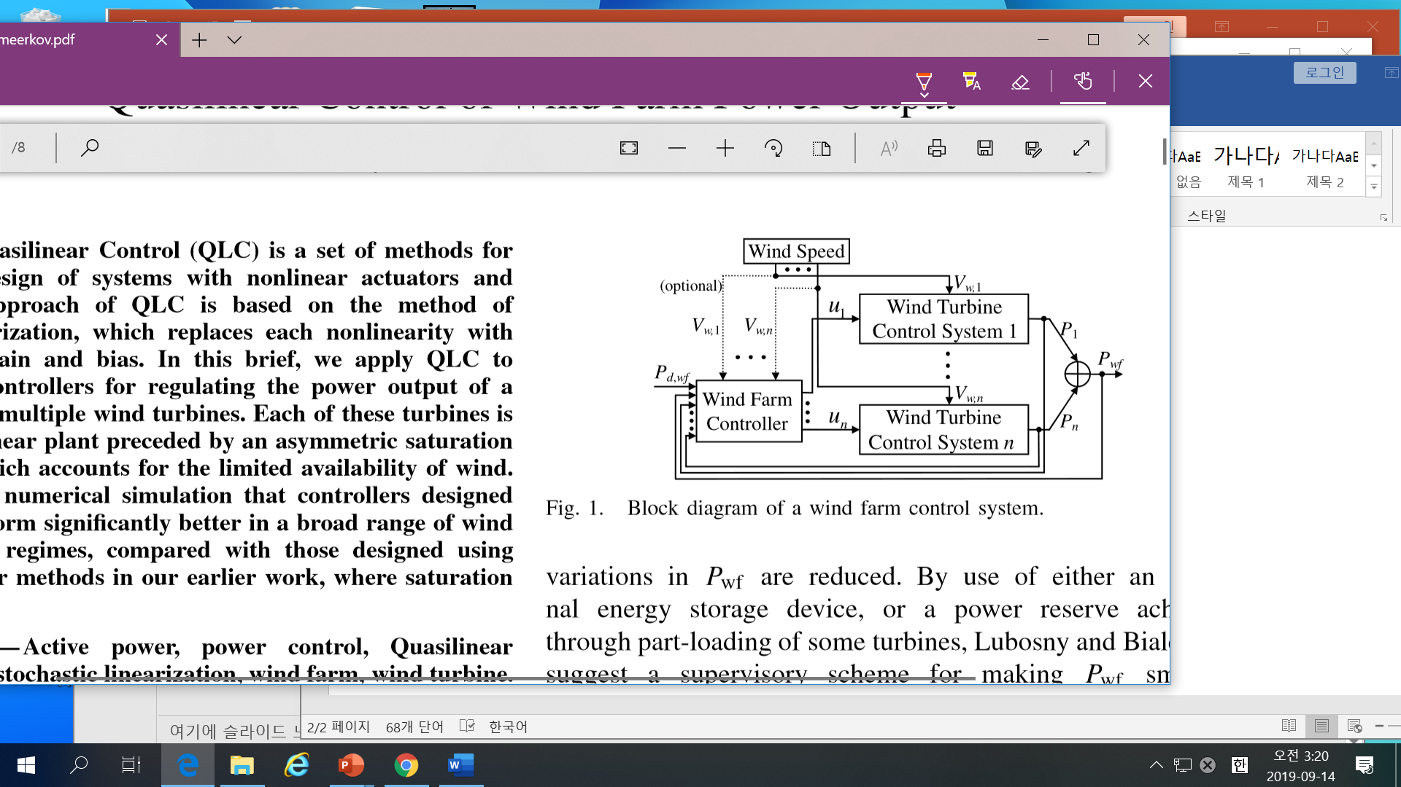
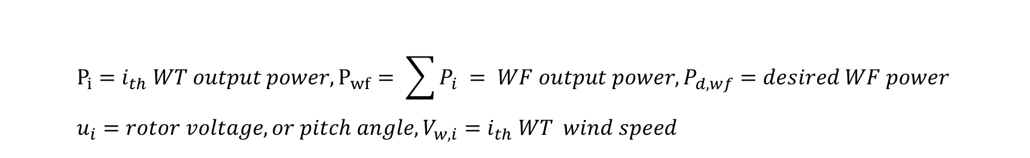
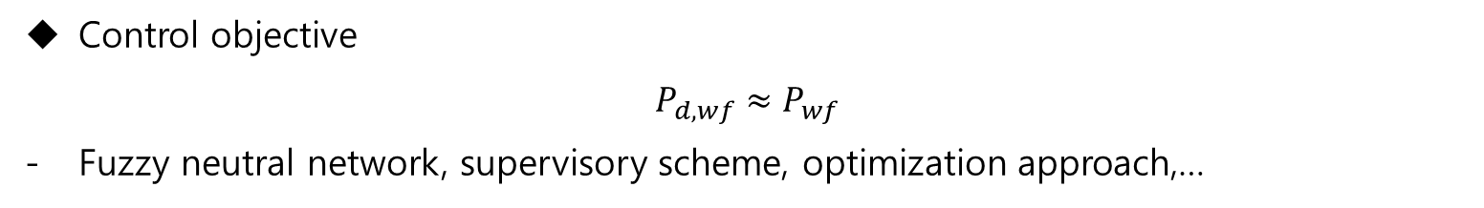
Quasilinear
3) Paper: “Quasilinear Control of Wind Farm Power output”
: 2015,IEEE
Problem Statement
$$P_{i}=i_{th} WT output power, P_{wf}= \sum{P_{i} }= WF output power, P_{d,wf}=desired WF power \\ u_{i}=rotor voltage,or pitch angle, V_{w,i}=i_{th} WT wind speed$$
Control objective
$$P_{d,wf}≈P_{wf}$$
Fuzzy neutral network, supervisory scheme, optimization approach,…

Slide 11
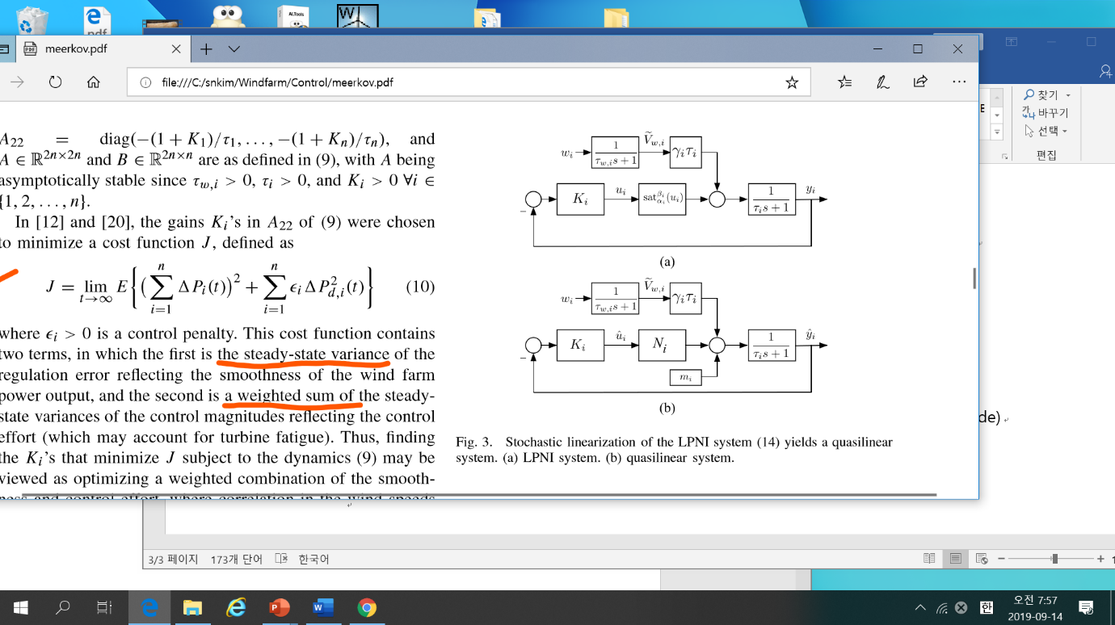
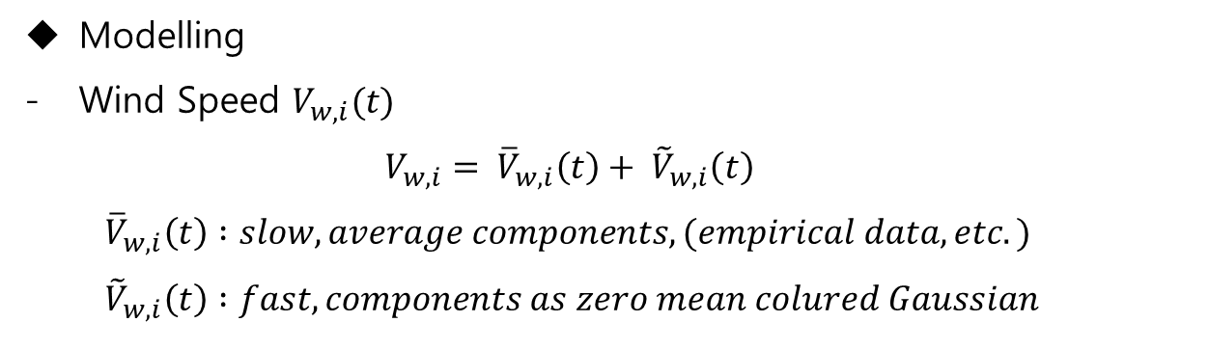
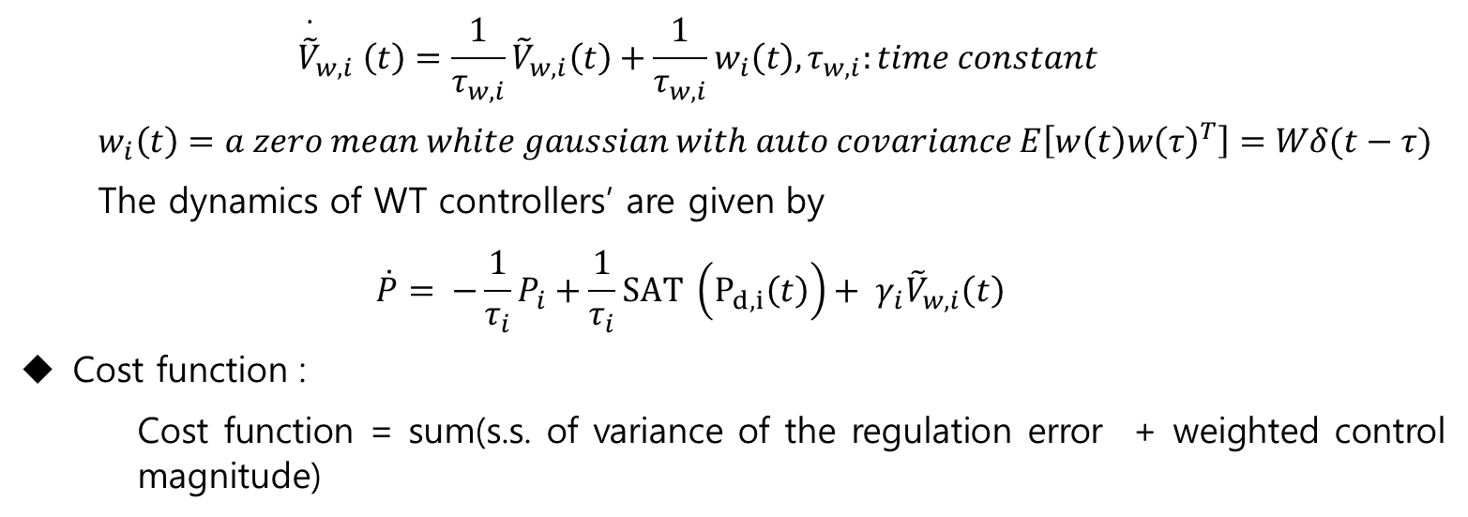
Modelling
Wind Speed $V_{w,i}(t)$
$$V_{w,i}= {\overline{V}}_{w,i}\left(t\right)+ {\tilde{V}}_{w,i}\left(t\right)$$
$${\overline{V}}_{w,i}\left(t\right) :slow, average components,(empirical data, etc.)$$
$${\tilde{V}}_{w,i}\left(t\right) :fast, components as zero mean colured Gaussian$$
Quasilinear
$${\overset{∙}{\tilde{V}}}_{w,i} \left(t\right)=\frac{1}{τ_{w,i}}{\tilde{V}}_{w,i}\left(t\right)+\frac{1}{τ_{w,i}}w_{i}\left(t\right),τ_{w,i}:time constant$$
$$w_{i}\left(t\right)=a zero mean white gaussian with auto covariance E\left[w\left(t\right)w{\left(τ\right)}^{T}\right]=Wδ(t−τ)$$
The dynamics of WT controllers’ are given by
$$\dot{P}= −\frac{1}{τ_{i}}P_{i}+\frac{1}{τ_{i}}SAT \left(P_{d,i}\left(t\right)\right)+ γ_{i}{\tilde{V}}_{w,i}\left(t\right)$$
Cost function :
Cost function = sum(s.s. of variance of the regulation error + weighted control magnitude)

Slide 12
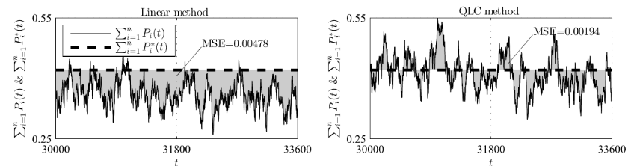
Quasilinear
Conclusion :
+ The cost function of QLC is better than that of the Linear.
+ One realization shows the MSE of QLC is smaller than the that of Linear.

Slide 13
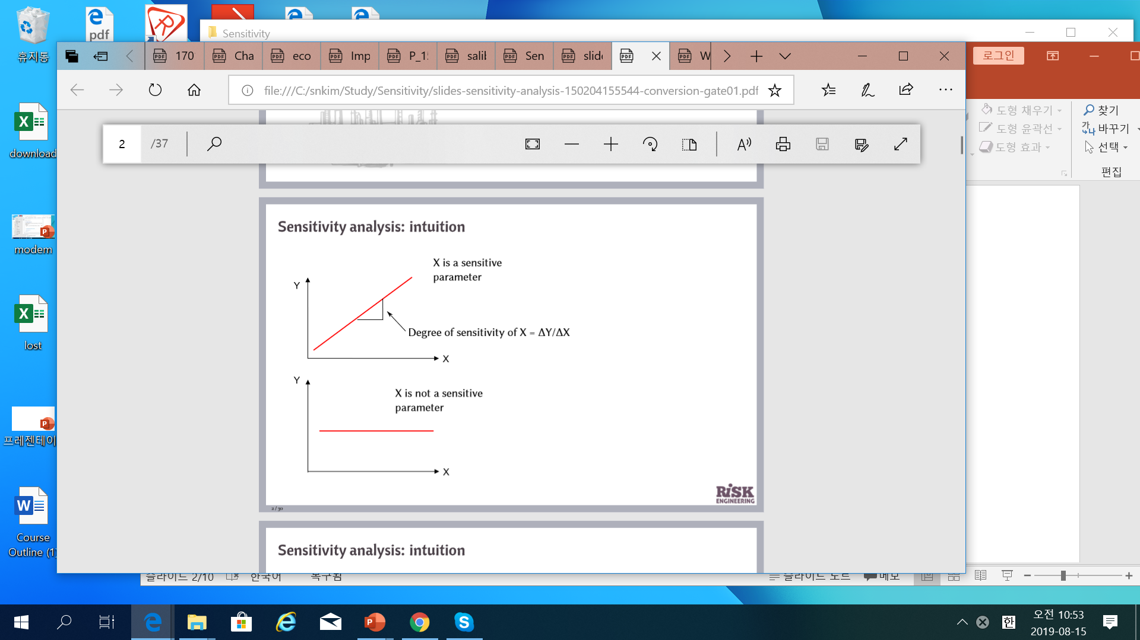
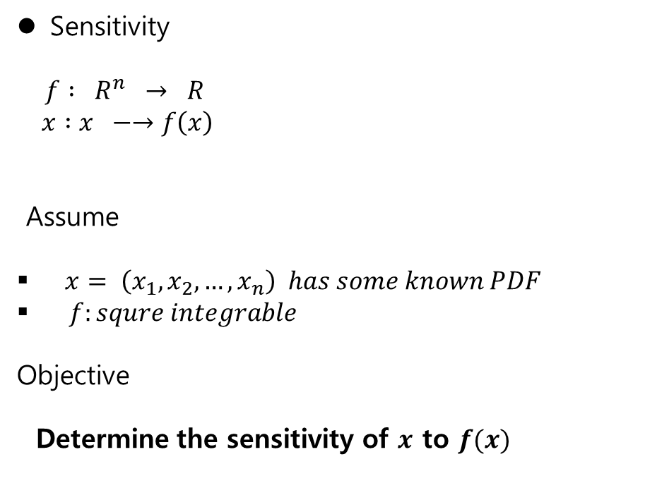
GSA
Sensitivity
$f : R^{n} → R$
$x :x −→f\left(x\right)$
Assume
$x= \left(x_{1}, x_{2},…, x_{n}\right) has some known PDF$
$f:squre integrable$
Objective
Determine the sensitivity of $x$ to $f(x)$
Deterministic system

Slide 14
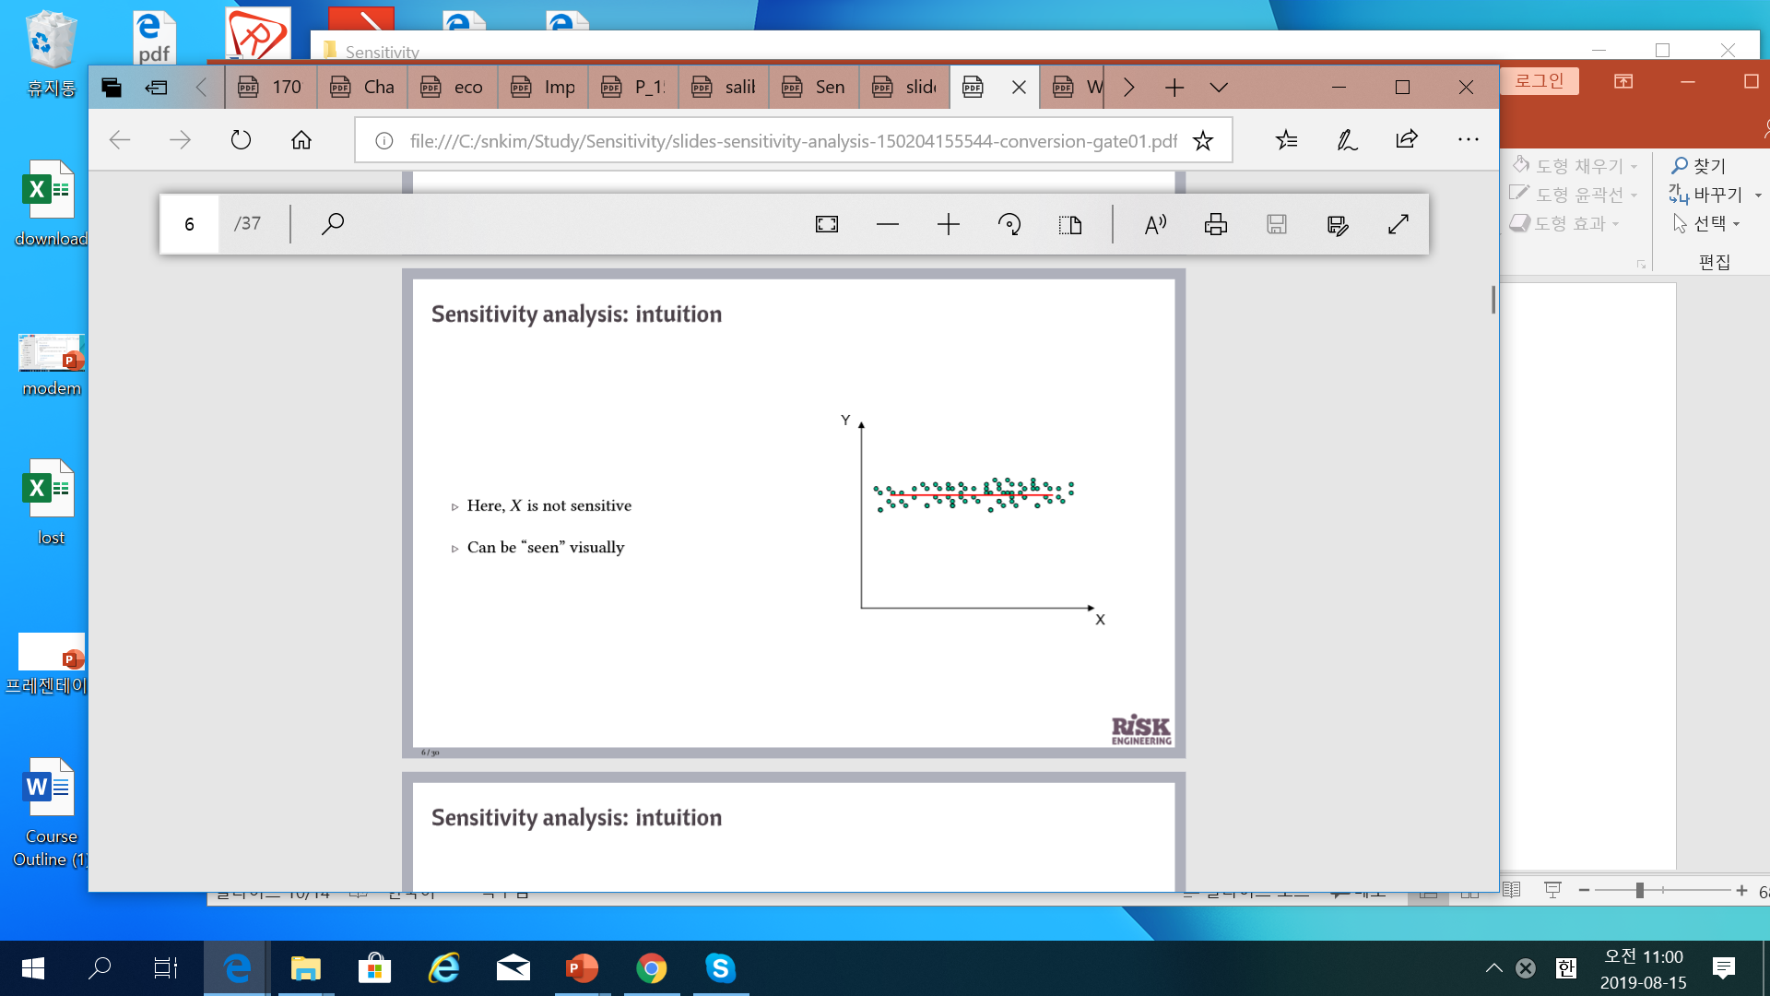
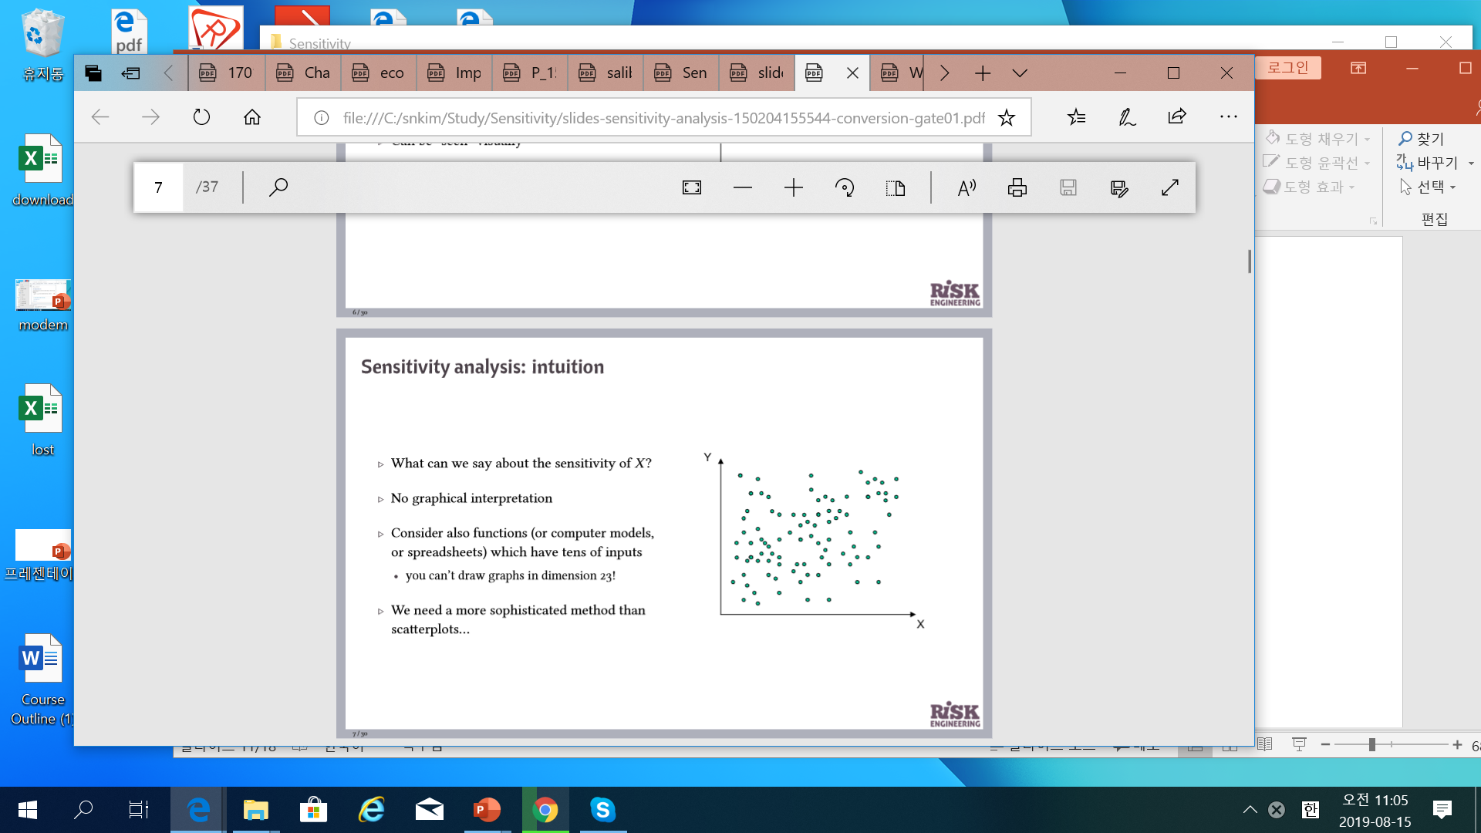
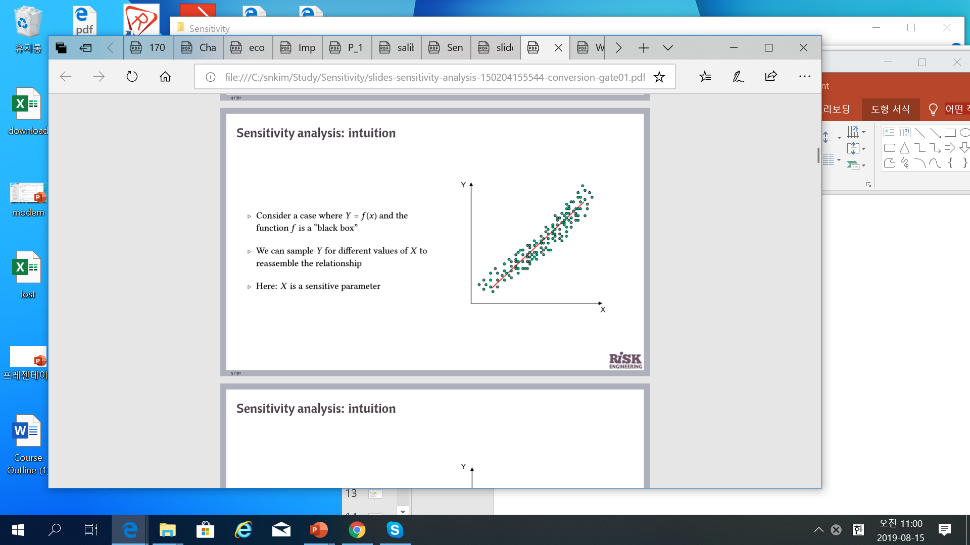
GSA
1) Concept : Stochastic System
Which one is the most sensitive?

Slide 15
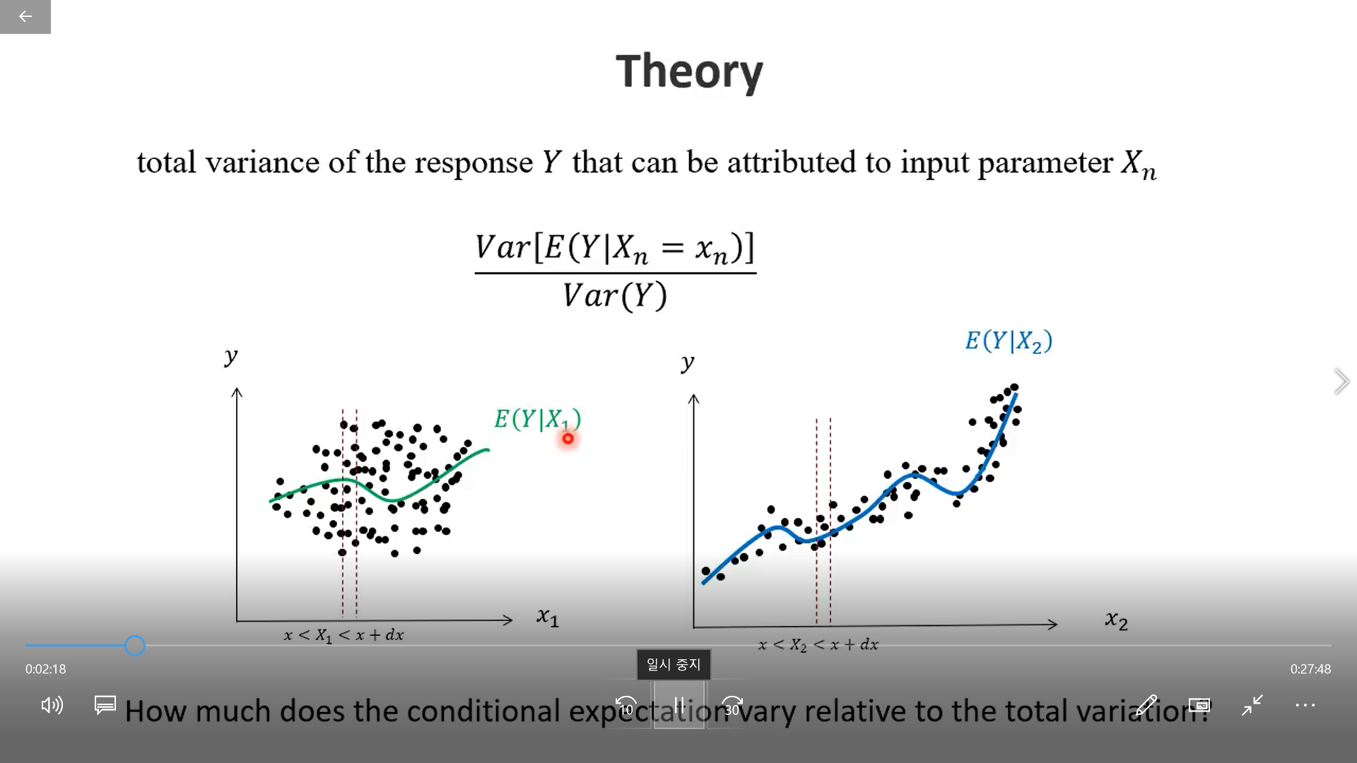
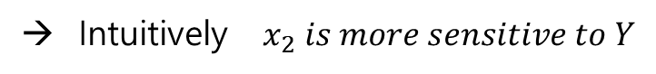
GSA
2) Sobol’s Sensitivity
$Y=f\left(X_{1}, X_{2}\right)$ , which one of $(X_{1}, X_{2})$ is more sensitive to Y? how to characterize the sensitivity?
→ Intuitively $x_{2} is more sensitive to Y$
// youtube: Sensitivity Analysis Global

Slide 16
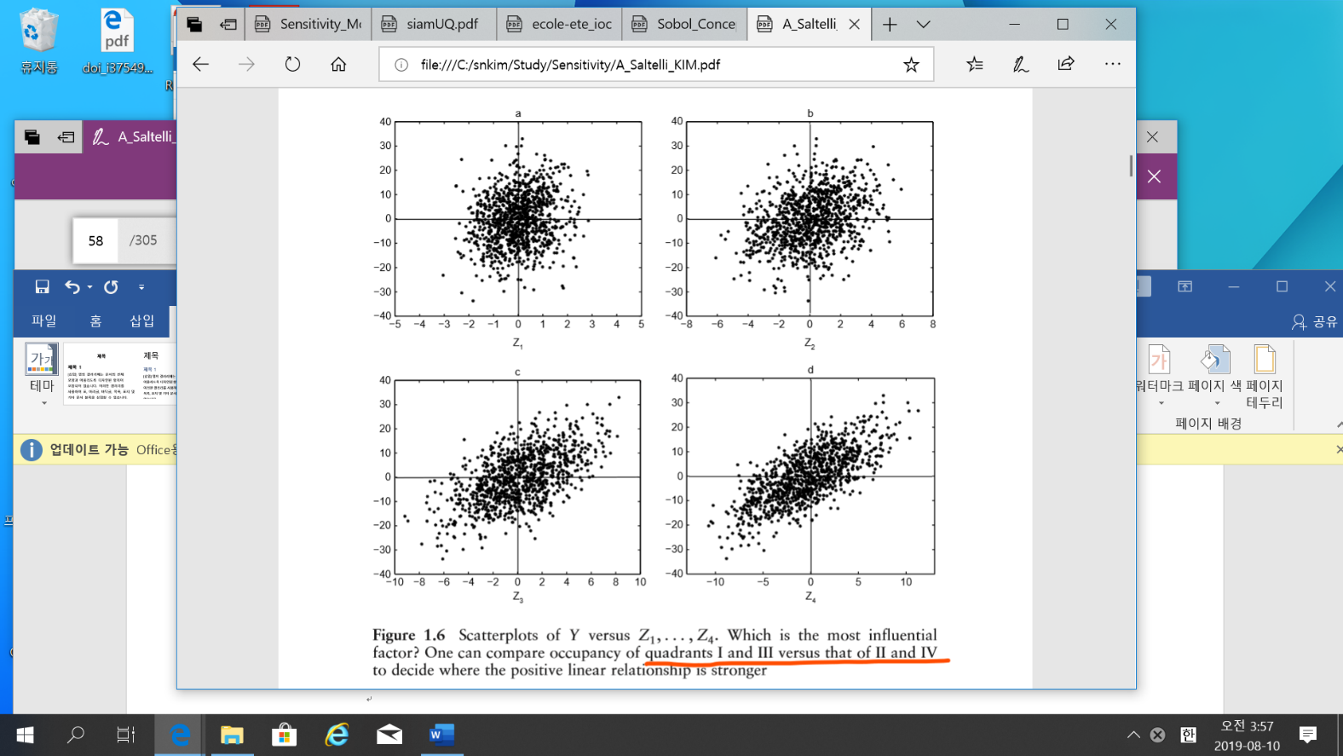
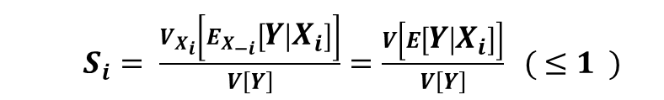

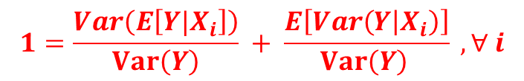
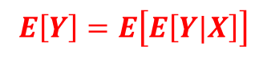
3) Sobol Sensitivity Index - The first order / Total sensitivity index
- The First Order Sensitivity
- The Total Sensitivity
Which parameter is the largest of the first order sensitivity index?
GSA
Functionals of the conditional probability
$S_{i}= \frac{V_{X_{i}}\left[E_{X_{−i}}\left[Y | X_{i}\right]\right]}{V\left[Y\right]}=\frac{V\left[E\left[Y | X_{i}\right]\right]}{V\left[Y\right]} ( ≤1 )$
$$E\left[Y\right]=E\left[E\left[Y|X\right]\right]$$
$Var\left(Y\right)=Var\left(E\left[Y|X\right]\right) + E\left[Var(Y|X)\right]$
${ S}_{Ti}=\frac{E\left(V\left(Y | X_{\sim i}\right)\right)}{V\left(Y\right)} =1 −\frac{V\left(E\left(Y | X_{\sim i}\right)\right)}{V\left(Y\right)}$
$$1=\frac{Var\left(E\left[Y|X_{i}\right]\right)}{Var\left(Y\right)} + \frac{E\left[Var\left(Y | X_{i}\right)\right]}{Var\left(Y\right) } , ∀ i$$

Slide 17
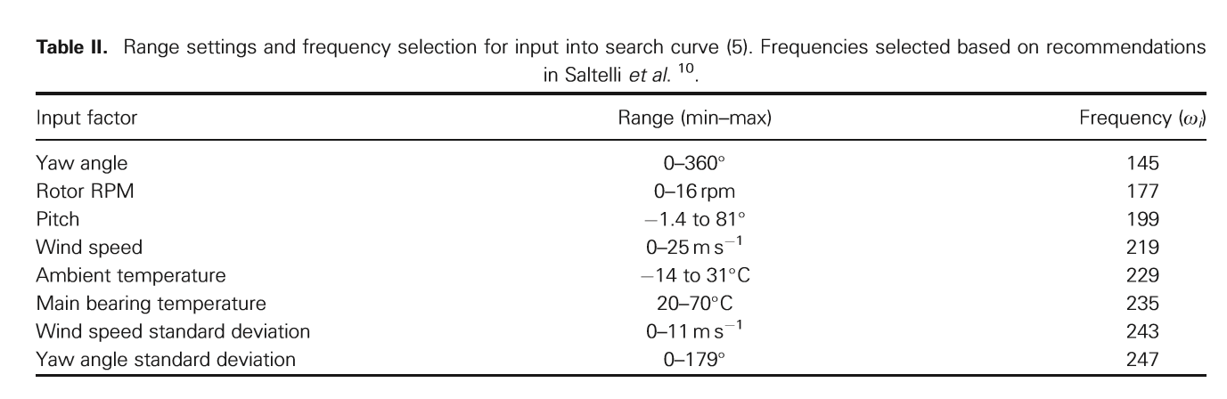
GSA
4) Paper: ”Global sensitivity analysis of wind turbine power output”
- Introduction : wind turbine wake effects.
- parameters: 8 data collected 2years / 10 min sampling
Sensitivity Analysis Method : FAST
to get the first / total sensitivity use FAST(Fourier Amplitude Sensitivity Test)¹⁾
¹⁾ FAST can get the first/total Sensitivity but not the interactive sensitivity.

Slide 18
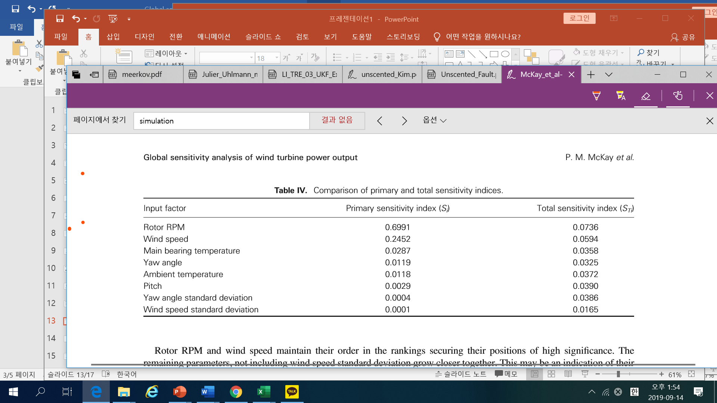
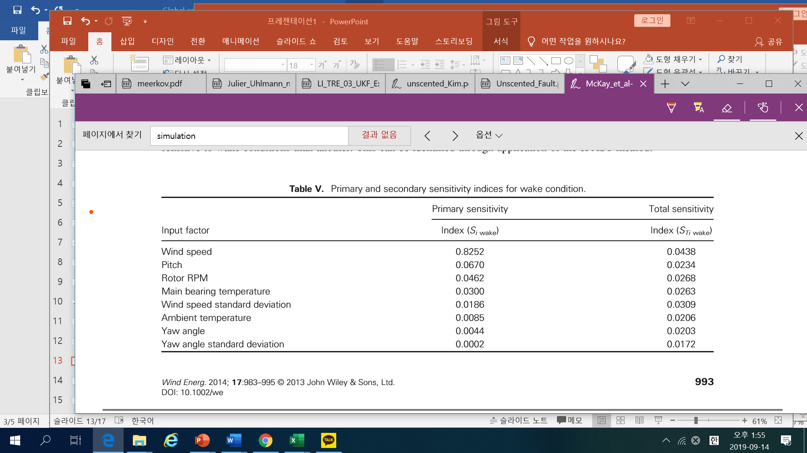
GSA
System Modelling
No explicit model, but by CNN(Convolutional Neural Network), implicit modelling used.
Results
(Upsteam WT)
(Downteam WT)

Slide 19
GSA
Conclusion
For a turbine operating in the wake of an upstream machine, power production is most sensitive to windspeed standard deviation above all parameters included in this study excluding wind speed itself.
In the wind farm, for optimal output power the effect of wake should be considered
→ Active wake control

Slide 20
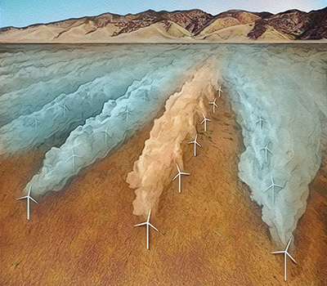
Wake
Wake: Wind Farm as a whole.” Steering wind power in a new direction: How skewing turbines boosts farm output”, 2019
https://news.stanford.edu/2019/07/01/steering-wind-power-new-direction/
wake – active wake control
-wakes from upstream generators can interfere with those downstream. Pointing turbines slightly away from oncoming wind – called wake-steering – can reduce that interference and improve both the quantity and quality of power from wind farms, and probably lower operating costs.
- power improvement at low wind speeds was particularly high because turbines typically stop spinning below a minimum speed.

Slide 21
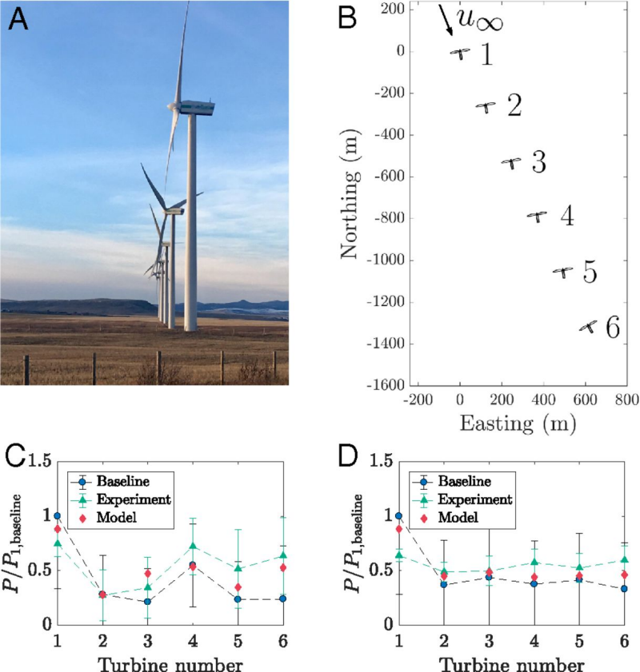
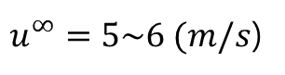
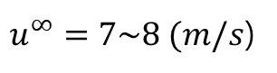
Conclusion
Wake
The overall power output of the farm increased by up to 47 percent in low wind speeds – depending on the angle of the turbines – and by 7 to 13 percent in average wind speeds. Wake steering also reduced the ebbs and flows of power that are normally a challenge with wind power.
$u^{∞}=5\sim 6 (m/s$)
$u^{∞}=7\sim 8 (m/s$)

Slide 22
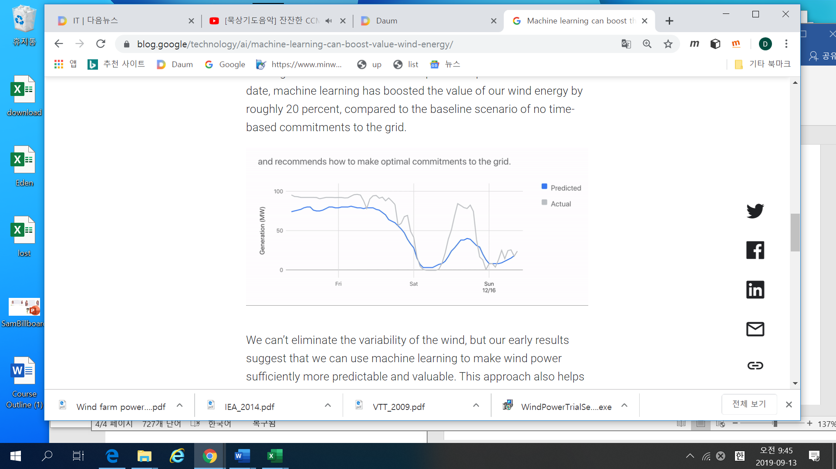
Prediction
Wind Energy Prediction: https://www.theverge.com/2019/2/26/18241632
/google-deepmind-wind-farm-ai-machine-learning-green-energy-efficiency
“Google and DeepMind are using AI to predict the energy output of wind farms”
- By prediction the wind energy production of 36 hours a head — compared to no time-based commitments to the grid — it has “boosted the value of our wind energy by roughly 20 percent.”
→ The prediction is to increase the output of the wind farm energy

Slide 23
Master for Wind Energy
Master thesis regarding “Wind Energy”
Univ. | year | topics | Interesting area
AAiT | 2013 | Hybrid power system | Welenchity
AAU | 2015 | Wind Energy Resource | Aysha wind farm
AAU | 2013 | hydro-wind hybrid | Hamsa Gasha
AAU | 2010 | Wind Energy Integration | Ashegoda
Haramaya | 2017 | Wind Energy | Chicho

